Slide 1
Global Warming
Jenan Al Saffar
Mrs. Timm
12F
March 10, 2013

Slide 2
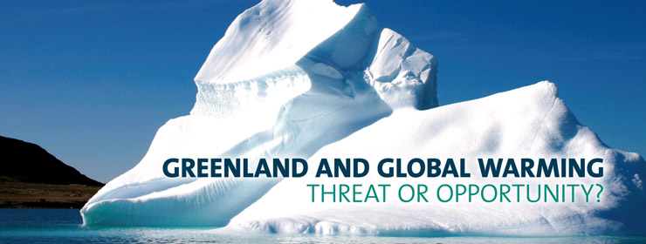
Introduction
“The warnings about global warming have been extremely clear for a long time. We are facing a global climate crisis. It is deepening. We are entering a period of consequences.”
Global Warming
- Greenhouse effect
- How is the society increasing global warming
- Solutions & how can the society decrease global warming
The effects of global warming will be reduced and the Earth will
be saved if the society started providing planet care.
Notes:
“The warnings about global warming have been extremely clear for a long time. We are facing a global climate crisis. It is deepening. We are entering a period of consequences.” – Al Gore (http://www.notable-quotes.com/g/global_warming_quotes.html) Global warming is a serious issue that was caused by humans since million years ago. Organizations and environmental associations keep spreading the awareness each year, however, people still do not consider this as a serious issue that will destroy future generations’ lives. This does not only affects the future, but the environment itself as well as the Earth will eventually come to a fast end. As we are entering a period of consequences, people do not realize how Earth is melting or how global warming is being increased by them to reduce their safety.

Slide 3
Brief History
The idea of fossil fuels combustion, which were defined as the main reason that caused global warming, predicted first by the scientist Arrhenius.
The natural greenhouse effect was found by this scientist when he related between the atmospheric carbon dioxide concentrations and temperature.
Gilbert Plass compiled the results to prove the negative impact of carbon dioxide and infrared radiation which caused global warming – warming the Earth.
Notes:
Global warming is not a problem that happened yesterday, or last year. As Elizabeth Kolbert has best determined, the world is now warmer than it has been at any point in the last two millennia, and, if current trends continue, by the end of the century it will likely be hotter than at any point in the last two million years. It is a serious world issue that should not be neglected anymore. People are not realizing that it will eventually put an end to this world as it destroys it day by day. It is necessary to guarantee a safe future for the future generation. Svante Arrhenius has discovered that the fossil fuels were the major effect behind global warming. When Gilbert evaluated these results where he analyzed that the increasing amount of CO2 absorbs the infrared radiation, causing the Earth to get warmer as this process continues. (http://www.lenntech.com/greenhouse-effect/global-warming-history.htm)

Slide 4
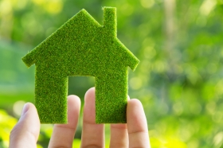
Greenhouse Effect
This effects refers to the process of the sun’s energy being trapped or absorbed by the atmosphere – bringing heat into the planet.
Include fossil fuels which release CO2
Reflection and process of the radiation and green gases from the sun, through the atmosphere, until the Earth
Notes:
The Earth would be a cold place if the greenhouse did not trap heat into the Earth. Regarding greenhouse effect, humans are speeding up the process of global warming by emitting these kind of gases which increase the capacity of heat. (http://www.skepticalscience.com/What-is-Global-Warming-and-the-Greenhouse-Effect.html)
Greenhouse image (http://www.google.com.bh/imgres?start=361&um=1&hl=en&sa=N&biw=1280&bih=659&tbm=isch&tbnid=RfCiAeLtr0-rUM:&imgrefurl=http://www.enn.com/topics/green_building&docid=ehUHXaSllepNBM&imgurl=http://www.enn.com/image_for_articles/45640-1.jpg/medium&w=280&h=186&ei=cDo2UdbJFcjKsgbXpYDoDA&zoom=1&ved=1t:3588,r:68,s:300,i:208&iact=rc&dur=663&sig=112771005927496808414&page=19&tbnh=148&tbnw=222&ndsp=19&tx=117&ty=52)

Slide 5
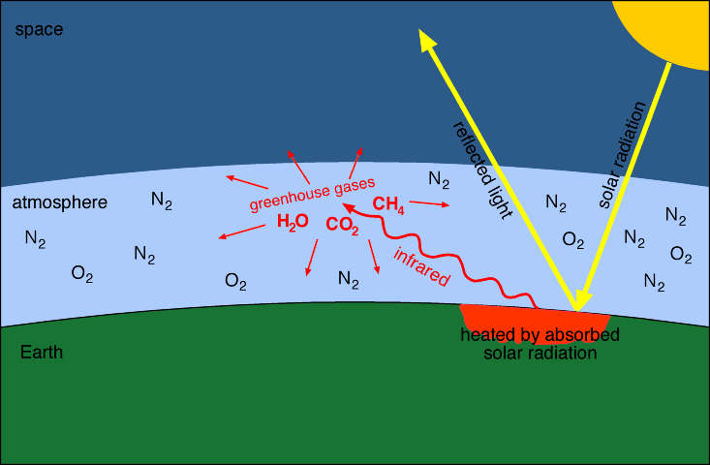
Visual Process
Notes:
When radiation (rays of heat) travels through the atmosphere to reach the Earth, it travels back into the atmosphere (air that wraps the Earth). The gases that return back to the atmosphere stop the heat from escaping into space. Therefore, they are known as the “greenhouse effect” because the process is similar to a green house’s windows and its reflection of gases in and out – saving some heat inside.
Green gases process image (http://www.google.com.bh/imgres?imgurl=http://www.columbia.edu/~vjd1/greenhouse.gif&imgrefurl=http://www.columbia.edu/~vjd1/greenhouse.htm&h=480&w=733&sz=20&tbnid=USsDS37caSxEkM:&tbnh=81&tbnw=123&prev=/search%3Fq%3Dgreenhouse%2Beffect%2Band%2Bglobal%2Bwarming%26tbm%3Disch%26tbo%3Du&zoom=1&q=greenhouse+effect+and+global+warming&usg=__B157RIUV_K9yWDvxs03xz6ArZz0=&docid=erK3d0td1iVRvM&hl=en&sa=X&ei=ais7UbvcKM7htQa1-ICQAg&sqi=2&ved=0CE8Q9QEwBQ&dur=5920)

Slide 6
Pollution
Energy conservation to avoid the following:
Power plants that generate electricity
    Release arsenic
    Mercury
    Other metals
    Acid gases
Threaten humans’ health and the environment
Heats the climate
Notes:
Going deep in the meaning of energy conservation will bring some awareness to keep most individuals protective for their environment. Being introduced, energy conservation and pollution seem to be going hand in hand. In order for the society to conserve energy, people should use less of energy service in order to reduce energy – avoiding pollution. Saving electricity, recycling, or even forming a hydroelectric power will definitely help in forming a healthier society with less pollution. (http://www.globalchange.umich.edu/globalchange2/current/lectures/pollution_control/pollution_control.html)

Slide 7
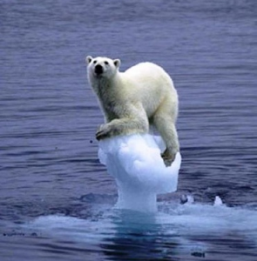
Sea level rise
Effect on aquatic ecosystems
Caused by high temperature and melting ice caps
Kills animals who live in glaciers
Higher temperatures make the water of sea
levels expand
Rising sea levels may threaten the
low-lying areas like the Netherlands
(sink)
May force a lot of people to migrate
Notes:
High temperatures have caused a melting of ice caps in many places like Antarctica. From this point, many things have turned to the worse where the sea level rise was caused by the melting caps and glaciers. Species that live in cold environments such as polar bears will be extinct due to all these reasons. So, pollution which plays a big role in heating up the climate also affects in rising the sea level by humans’ daily use in factories, smoking, cars, airplanes, and burning trees. This kills polar bears and all kinds of animals that live in glaciers. If these ice caps and glaciers melt, they tend to affect the aquatic ecosystems. Species may not be able to cope with other habitat; thus, they die. According to migration, millions of people will lose their homes because of the flood in their areas. Hence, people should be aware in protecting their globe in order to save their lands, animals, and themselves because the issue of the rising sea level is one big threat regardless of the global warming.
Polar bear image (http://www.google.com.bh/search?hl=en&site=imghp&tbm=isch&source=hp&biw=1280&bih=659&q=melting+ice+caps&oq=melting+ice+caps&gs_l=img.12..0l3j0i5j0i24l6.3219.16752.0.19478.18.5.1.0.0.0.3665.4672.0j1j3j9-1.5.0...0.0...1ac.1.5.img.ISp_j0bbh_I#imgrc=kl5I0KGx2NSi6M%3A%3B6to7QRBd71UvkM%3Bhttp%253A%252F%252F3.bp.blogspot.com%252F_POsysbp2gE8%252FS8uN5cOwrGI%252FAAAAAAAAG_o%252Fqd9ZxYI-eVM%252Fs1600%252F65%252BThe%252BIce%252BCaps%252Bare%252BMelting.jpg%3Bhttp%253A%252F%252Ffinancialpodcast.blogspot.com%252F2010%252F04%252Fearth-day-series-putting-price-tag-on.html%3B446%3B617)

Slide 8
Climate Change
Affect the various types of crops which are grown and harvested in different places
High temperature may be beneficial for SOME crops like wheat or rice
Not beneficial for other types of plants
Changes in the amount of rainfall may destroy plant growth
Lack of food in some countries: starvation / hunger
Notes:
The world with its different parts have essentially experienced the different climate changes. Whether it is heavy rain, or extreme cold, wet, or hot temperature. Both have great impacts over the environment (people, plants, animals). Severe drought, floods, frequent wildfires, and tropical storms are often caused by climate change. The weather in general now hold pollution more than before. This is another reason why climate change impacts the environmental sectors. Not only that, but the different organisms that may not adapt with climate changes will die. As it is known, climate change is a big threat to pandas and polar bears. This will leave negative consequences behind the future generations. (http://climate.nasa.gov/effects)

Slide 9
Environmental effects
Agriculture
Human health
Floods and storms will affect the society
People living in poverty will not be able to cope with the negative impacts caused by global warming
Notes:
Agriculture is affected by rising sea levels and pollution, causing diseases that may destroy the plants’ environment. Moreover, this is where water resources get affected as well. Temperature increase causes the reservoirs to dry up in cases of blockage in dry areas where there is no rain. Fresh groundwater that supplies with salt water may be polluted by rising sea levels. Unfortunately, humans are another part of the whole environment that are affected by global warming. Relatively, lacking plant growth will obviously stop carbon dioxide from reaching out to humans’ breath. Also, if humans get the disease from pollution, plants may be affected by being prevented from oxygen. “There may be more heat-related illnesses in hotter summers, and increased breathing problems as higher temperatures increase air pollution in cities, reducing air quality.” (http://www.helium.com/items/228729-global-warming-and-its-effect-on-society)

Slide 10
Who’s Responsible?
Humans
  Pollution
    airplanes
    cars
    factories
    greenhouse gases (emitted by people)
    burning fossil fuels
Notes:
Here, the word humans has been highlighted to make people realize that this issue is not a myth. Furthermore, materials that are being used daily by humans are listed to clarify the evidence of how they increase global warming and show their impact over the society and the globe as a whole. Specifically, pollution comes from smoking, factories, all types of vehicles that release green gases, etc. is what emits green gases. Taking into consideration, green gases were the major reason in how global warming was first created. (http://abcnews.go.com/blogs/technology/2012/07/whos-most-to-blame-for-global-warming/)

Slide 11
Recycling
Conserves valuable resources
Helps in conserving energy
Reduces Air and water pollution
Tree preservation
Saves water
Notes:
By recycling, global warming’s process will be no long speeding up to destroy our globe. These are simple ways of how recycling can help the society decrease global warming. Producing recycled paper is one way, where its production uses 65 percent less energy than paper production by raw materials. This is the major way that help in proceeding with the others like tree preservation. Recycling only one ton of paper saves around 17-20 trees from being cut down! This also saves carbon dioxide, which is our another advantage. Consequently, recycling bottles and all types and sizes of containers tends to save, or conserve energy. The benefits of conserving energy have already been mentioned previously. Hopefully, if half of these ways were practiced by the society, global warming as well as carbon emissions that contribute to it will be reduced. (http://greenliving.nationalgeographic.com/ten-ways-stop-global-warming-2381.html)

Slide 12
Melting Ice caps and glaciers Effects
According to the Natural Resources Defense Council, all of the glaciers in Glaciers National Park will be gone by 2070.
Rising global temperatures
Waterways and beaches get affected
Could impact transport
The Arctic could be ice free by 2040
Animal Extinction
Notes:
Melting ice caps will not only affect people and their homes in future, but even animals. In fact, this problem could cause the loss of some animals like polar bears, seals, etc. in certain areas of the world. Countries with high population like china will have to migrate eventually to avoid flood risk areas unless they come up with a solution to stay away from rising sea levels. After looking up for some possible solutions, it seems that the local governments and property owners have been taking initiatives to help protect their places against rising sea levels in their beaches. This will probably save their society from migrating or getting exposed to extreme weather (floods, storms, tornadoes). (http://www.nrdc.org/globalwarming/fcons/fcons4.asp)

Slide 13
Tips and Solutions
Using the clean air act to limit carbon pollution
Eating frozen food at often times since frozen food uses 10 times more energy to produce
Reducing the number of people in methods of transportation(s) and long trips
Using hydroelectric power for clean air, safer electricity, and a healthier environment
Cover pots while cooking
Notes:
It is guaranteed that global warming will be reduced with a certain percentage if only one of these steps gets practiced within a year by at least one part of the world. People will have to proceed in these steps to gain a better environment without risks.
Recycling, eating frozen food will certainly conserve energy and co2. Another important solution that people should practice on daily basis is being gather in one car with the maximum number of people that could get in. This includes long trips, short rides, and daily usage. A lot of solutions and tips are available to help the society decrease global warming as much as possible. Yet, it is our responsibility to apply that in our environment. (http://greenliving.nationalgeographic.com/ten-ways-stop-global-warming-2381.html)

Slide 14
Conclusion
The effects of global warming will be reduced and the Earth will be saved if the society started providing planet care.
Pollution, energy conserving, as well as lifestyle management play a key role in prevention and control of global warming.
Spread awareness
For Earth, it means life will have to either adapt or die.
Notes:
The effects of global warming will be reduced and the Earth will be saved if the society started providing planet care. Charity campaigns should be held to spread the awareness and introduce the ways of protecting the globe with its environment since a lot of people do not realize the actual importance behind global warming and its impacts. In a matter of fact, many people do not even know the meaning of global warming. Simply, several ways can be used to help solve this issue as global warming threatens our lives.

Slide 15
Works cited
Blakemore, Bill. "Who’s ‘Most to Blame’ for Global Warming?" ABC News. ABC News Network, 22 July 2012. Web. 17 Feb. 2013.
Carpentier, Megan. "Could Overpopulation Save The Earth From Global Warming?" Io9. Warm Theories, 15 June 2009. Web. 17 Feb. 2013.
"Climate Science Glossary." Skeptical Science. N.p., n.d. Web. 09 Mar. 2013. Web, 09 Mar. 2013.
Crawford, Benna. "Things to Do to Reduce Global Warming | National Geographic." Green Living on National Geographic. Demand Media, n.d. Web. 17 Feb. 2013.

Slide 16
Works cited
Enzler, S.M. "History of the Greenhouse Effect and Global Warming." History of the Greenhouse Effect and Global Warming. Lenntech - Water Treatment Solutions, n.d. Web. 09 Mar. 2013.
Feinstein, Amy. "MNN - Mother Nature Network." MNN - Mother Nature Network. N.p., 15 Mar. 2012. Web. 17 Feb. 2013.
Goebel, Jennifer. "Global Warming and Its Effect on Society." Helium. Helium, 23 Mar. 2007. Web. 17 Feb. 2013.
"Impacts of Global Warming." Impacts of Global Warming. N.p., n.d. Web. 17 Feb. 2013.

Slide 17
Works cited
Marks, Ronald. "How Global Population Growth Is Creating Serious EnvironmentalÂ Problems." About.com Environmental Issues. N.p., n.d. Web. 17 Feb. 2013.
Nelson, Richard. "Effects of Global Warming to Earth and Society." Examiner.com. N.p., 18 Apr. 2011. Web. 17 Feb. 2013.
Radcliff, Michelle. "How to Take Action to Reduce Global Warming." Green Living. N.p., n.d. Web. 17 Feb. 2013.
Seaman, Greg. "Eartheasy." Eartheasy Blog Global Warming Climate Change What We Can Do about It Comments. N.p., 3 Mar. 2009. Web. 17 Feb. 2013.

Slide 18
Works cited
Singh, Satyavrat. "Save Earth from Global Warming." Web log post. Satyavrat Singh RSS. Satyavrat, 05 June 2012. Web. 17 Feb. 2013.
Smith, Noah. "The End of Global Warming: How to Save the Earth in 2 Easy Steps." The Atlantic. Noahpinion, 17 Sept. 2012. Web. 17 Feb. 2013.

